Slide 1


Make Moldova biohub of biomedical startups
Serghei Mangul, Ph.D
Assistant Professor
The University of Southern California,
School of Pharmacy
@serghei_mangul

Slide 2

Computational medicine
Computational medicine, a fast-growing method of using computer models and sophisticated software to figure out how disease develops -- and how to thwart it -- has begun to leap off the drawing board and land in the hands of doctors who treat patients for heart ailments, cancer and other illnesses.
Winslow, Raimond L., et al. "Computational medicine: translating models to clinical care." Science translational medicine 4.158 (2012): 158rv11-158rv11.

Slide 3
Technology and data enables precision medicine
The most scientifically and technologically appropriate approaches can enable targeted and personalized way of diagnosing and treating disease.
Lack of diagnostic tests that can be performed at low-infrastructure sites, which serve most of the global population. Without these diagnostics, health-care workers do not know who should be treated and, just as importantly, who should not be treated

Slide 4
Synergy between computational and medicine promise to transform the health system
Big medical data generated from electronic health records (EHRs), medical imaging, genomic sequencing, payor records, pharmaceutical research, wearables, and medical devices can improve the treatment and diagnosis of the patients
Artificial intelligence algorithms enables to transform the smartphone into a medical device and perform point-of-care testing at home (e.g diagnoses infection from urine or saliva)

Slide 5
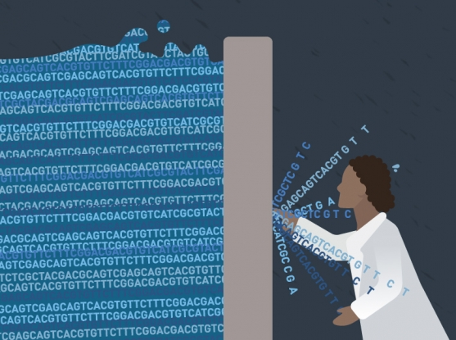
Medical researcher lack computational education
Computational skiils
S. Mangul, Interpreting and integrating big data in the life sciences, preprint -- https://doi.org/10.7287/peerj.preprints.27603v1

Slide 6
Introduce computational curriculum the higher education in Moldova
Introduce computational curriculum across the variant of life science and medical disciplines
Establish collaboration between USC and Moldovan Universities and allow top students to visit USC and work over summer
Boosting knowledge and technology by organizing summer schools and inviting scientists from top universities

Slide 7
Make Moldova biohub of biomedical startups
Moldova has strong technical education, but lacks knowledge how to apply those knowledge to cutting edge technologies in medicine
Train students in bioinformatics, computational skills, data science to make them competitive for biomedical startup

Slide 8
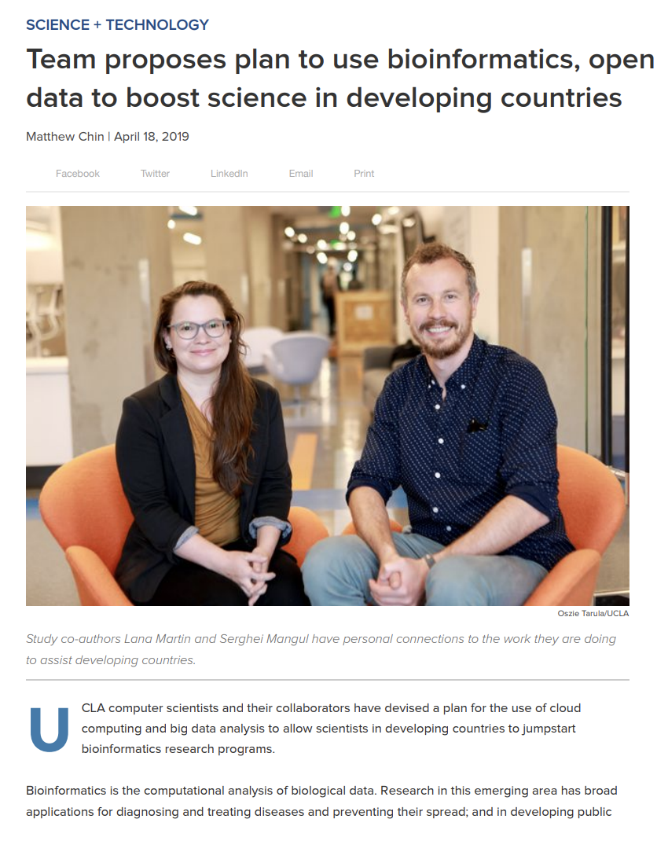
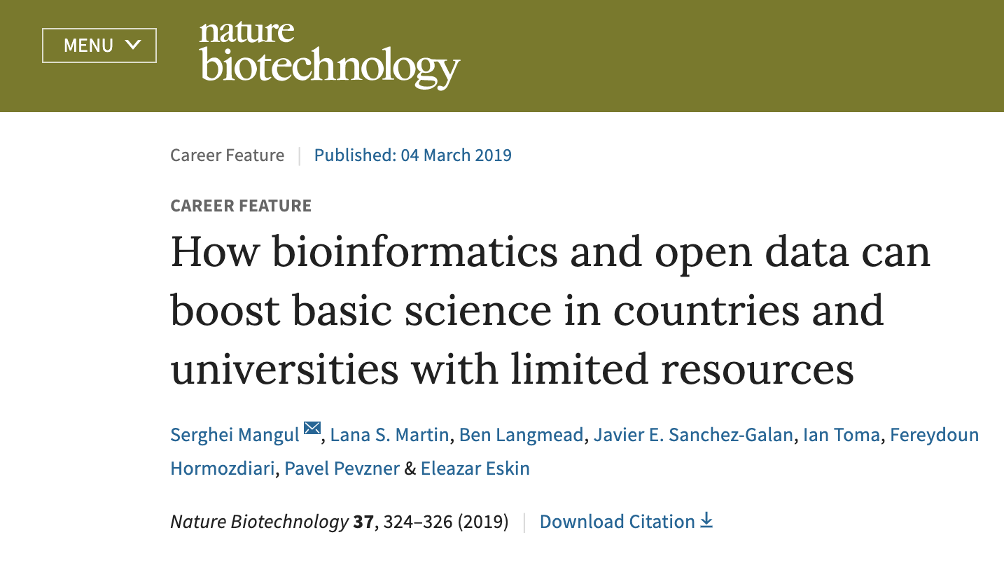
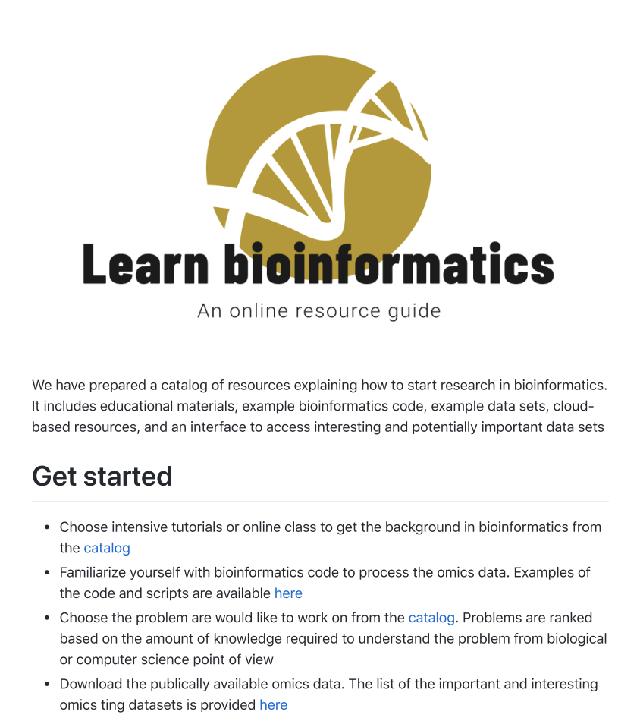
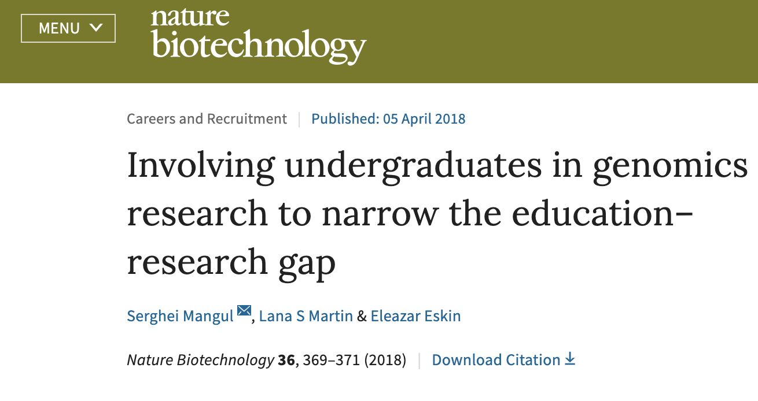
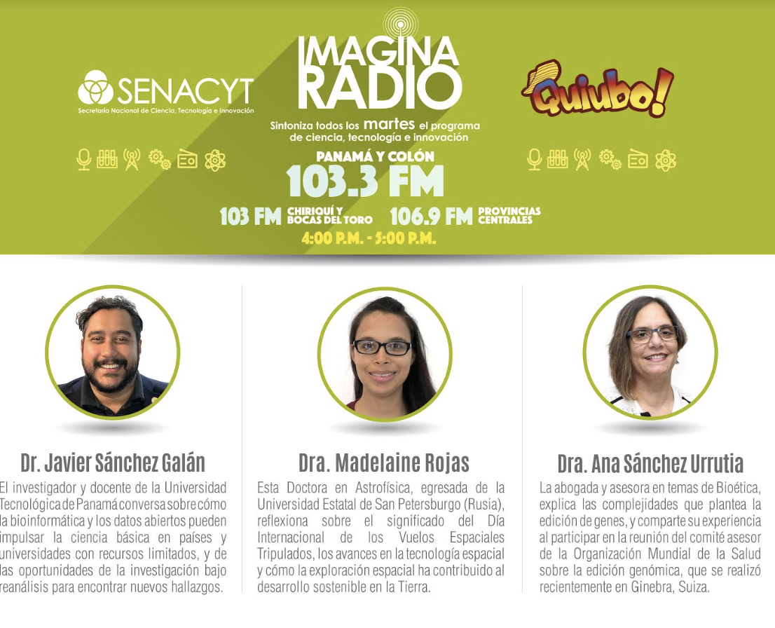
Plan to use bioinformatics, open data to biomedical science in developing countries

Slide 9
First steps of the biohub
Develop smart-phone AI-based diagnosis of infection diseases from salvia or urine samples.
Validate this solution in clinical settings
Integrate this into health care of Moldova
Seek for government support to establish ‘National Center of Computational Biomedical Research’

